Slide 1
IPL ANALYSIS - RCB IPL STRATEGY
G.Santosh kumar
26/10/2024

Slide 2
ABOUT IPL
ABOUT RCB
The IPL is a premier Twenty20 cricket league in India, renowned for its high-energy matches, city-based teams, and global player auction, which has popularized shorter formats of cricket and influenced leagues around the world.
It significantly drives the economy through sponsorships, broadcasting rights, and tourism, generating substantial financial benefits.
The Royal Challengers Bangalore (RCB), established in 2008 and based in Bangalore, is known for its star players like Virat Kohli and AB de Villiers, and plays its home matches at M. Chinnaswamy Stadium.
Despite not winning an IPL title yet, RCB is renowned for high-scoring matches and record-breaking performances, making it one of the most popular and commercially successful teams in the league.

Slide 3
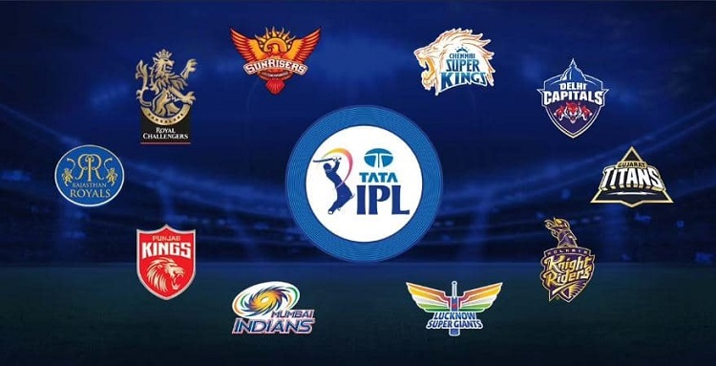
DATA OVERVIEW:
TOTAL NUMBER OF MATCH PLAYED DATA : 577
TOTAL NUMBER OF PLAYER’S DATA : 469
TOTAL NUMBER OF TEAMS DATA : 13
The IPL SQL database holds extensive data on various aspects of the Indian Premier League, including player details such as IDs, names, birth dates, batting hands, and bowling skills.
It tracks match specifics, including match IDs, dates, participating teams, and match outcomes.
The database records detailed ball-by-ball information, including runs scored, wickets taken, and types of dismissals, as well as extra runs and their types.
It stores information on seasons, such as Man of the Series and cap winners, along with data on cities and countries.
The organized structure of the database facilitates detailed analysis and querying of IPL data.

Slide 4

PROBLEM STATEMENT :
You are hired as a sport data analyst by RCB where the team is looking for top-performing and reliable players to win tournaments, considering both on-field performance and value for money in mega player auction of 2017.
Your task is to come up with strategies/suggestions regarding selecting the best-performing players and optimizing player auction investments.

Slide 5
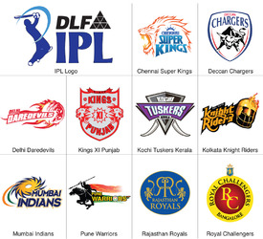
IPL TEAMS OVERVIEW :
IPL CHAMPIONS
TEAM PLAYING
YEAR | WINNER
2008 | Rajasthan Royals
2009 | Deccan Chargers
2010 | Chennai Super Kings
2011 | Chennai Super Kings
2012 | Kolkata Knight Riders
2013 | Mumbai Indians
2014 | Kolkata Knight Riders
2015 | Mumbai Indians
2016 | Sunrises Hyderabad

Slide 6


TOP 10 RUN SCORERS AND WICKET TAKERS IN IPL :

Slide 7
CONSISTENT BATSMENS – BOWLERS IN IPL:
The most consistent batsmen in IPL history scored over 700 runs in a seasons.
The most consistent bowlers in IPL history took at least 15 wickets in a seasons.

Slide 8
CONSISTENT ALL ROUNDERS IN IPL:
These players have scored over 1000 runs and taken more than 30 wickets. They excel in both batting and bowling.
consistence All rounder’s in overall seasons of the IPL ,They scored more then 400 runs and took 8 wickets in 4 out of 9 seasons.
PLAYER NAME | BATTING SESSIONS | BOWLING SESSIONS
JH Kallis | 6 | 4
KA Pollard | 6 | 4
SR Watson | 6 | 5

Slide 9
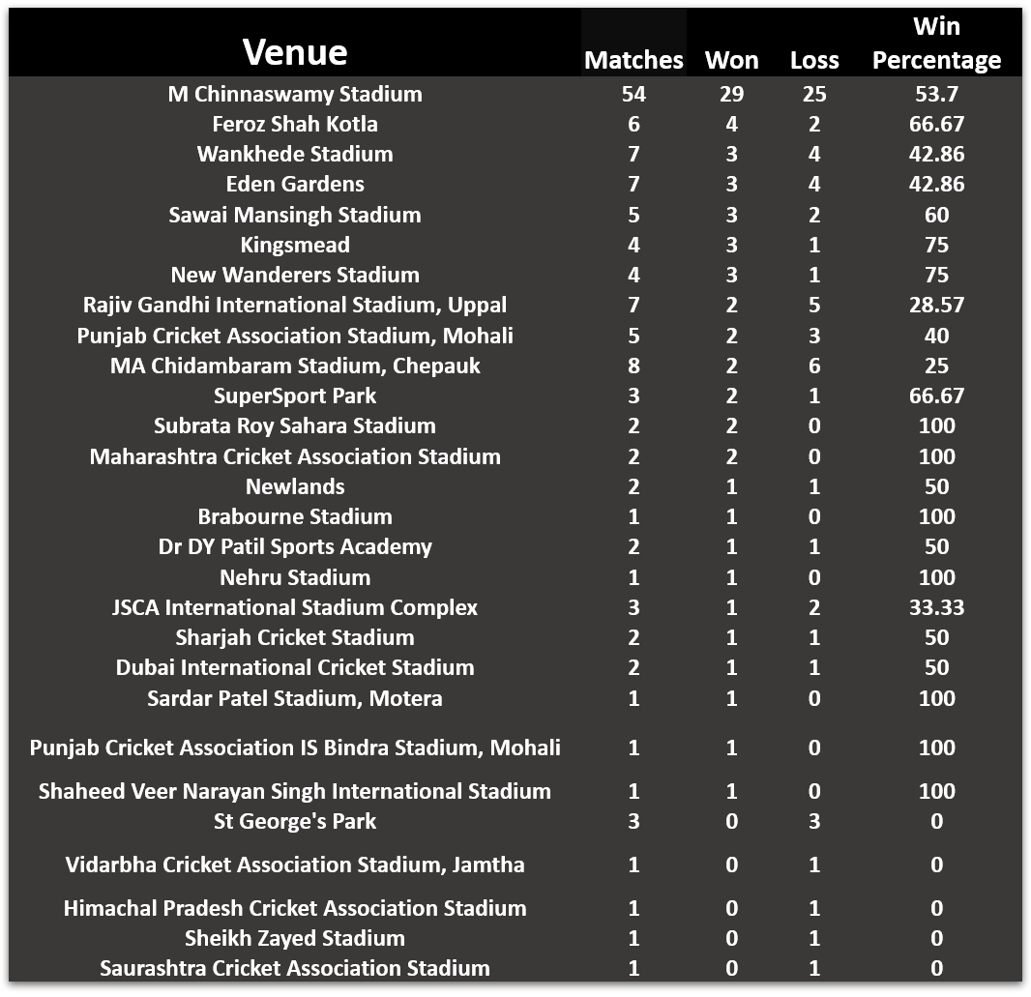
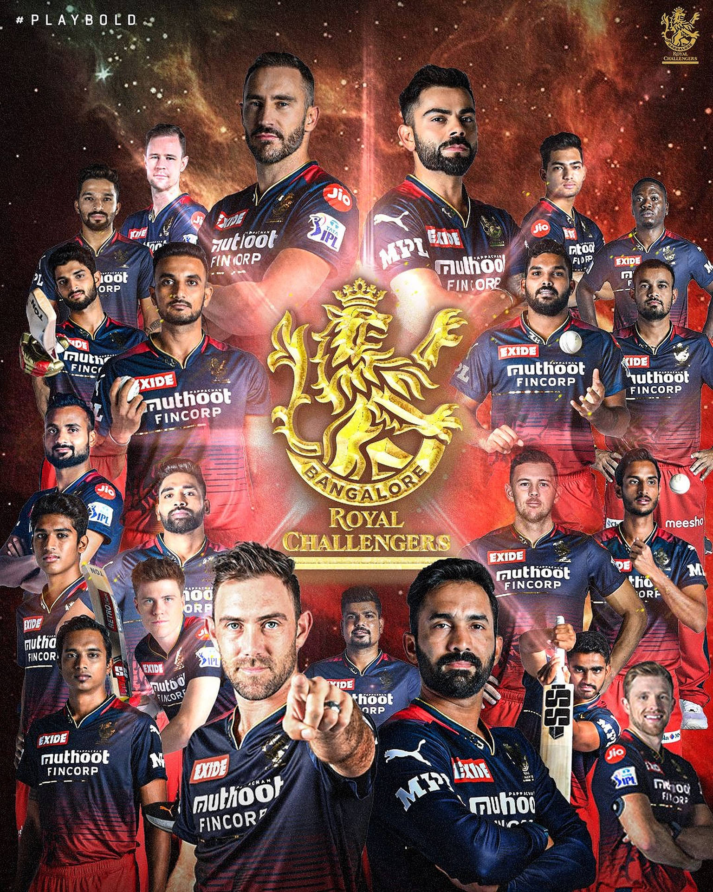
RCB RECORDS ACROSS ALL VENUE :

Slide 10

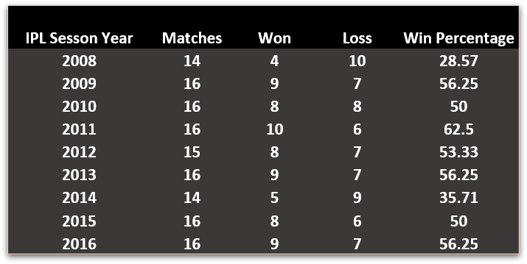
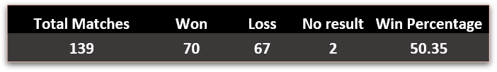
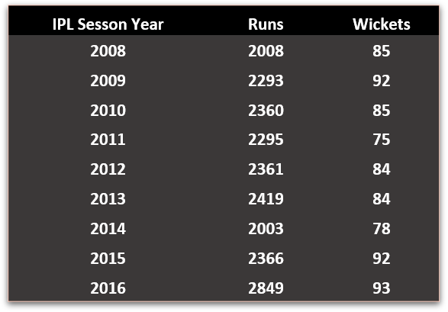
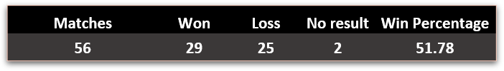
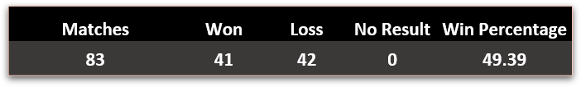
RCB STATISTICS:
RCB PREVIOUS SESSON RECORDS
RCB ALL MATCHES RECORD
RCB PREVIOUS SESSON RUNS AND WICKETS
RCB HOME MATCHES RECORD
RCB HOME MATCHES RECORD

Slide 11
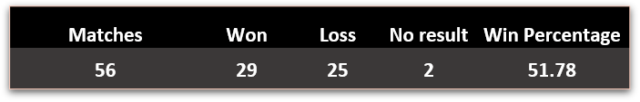
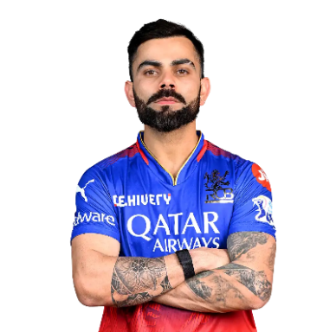
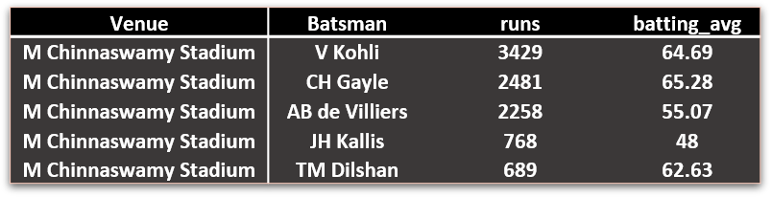

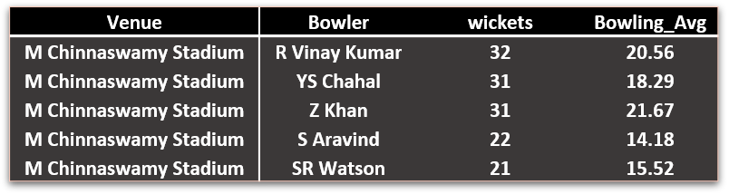
RCB RECORD M Chinna swamy Stadium(HOME)GROUND:
RCB HOME MATCHES RECORD
TOP 5 RUNS SCORERS IN RCB HOME
TOP 5 WICKET TAKERS IN RCB HOME

Slide 12
RETAINED PLAYERS AND NEW PLAYERS SELECTION :
V Kohli
AB de Villiers
KL Rahul
YS Chahal
HV Patel
T HEAD
Retained Players : Above 6 players retained due to good performance and fitness.
Released Players : All others released due to low performance and fitness issues.
New Additions :
Batting: M Vijay (reliable opener), DA Miller (powerful middle-order hitter).
All-Rounders: HH Pandya, RA Jadeja, DJ Bravo, JP Duminy, V Shankar, N Rana (balanced and versatile options).
Spin Bowling: Kuldeep Yadav (wrist spin), R Ashwin (experienced off-spin).
Pace Attack: MA Starc (left-arm pace), PJ Cummins (fast bowling) to strengthen pace options.
These additions aim to make RCB's squad well-rounded and balanced.

Slide 13
RCB SQUARD FOR IPL-10 2017 (AFTER AUCTION)
BATSMENS:
AB de Villiers
KL Rahul
(VC&WK)
V Kohli(C)
T HEAD
DA Miller
M Vijay
ALL ROUNDERS
H Pandya
R Jadeja
DJ Bravo
N Rana
JP Duminy
V Shankar
BOWLER’S
MA Starc
HV Patel
YS Chahal
PJ Cummins
R Ashwin
Kuldeep Yadav

Slide 14
RCB Playing XI and Substitutes:
Playing XI
V Kohli (Captain) - Provides stability and leadership.
TM Head - Brings aggression at the top.
AB de Villiers - Key finisher and middle-order strength.
KL Rahul (VC) (WK) - Flexibility in batting, anchors or accelerates as needed.
HH Pandya - Dynamic all-rounder who adds depth to both batting and bowling.
RA Jadeja - All-rounder with versatile skills.
DJ Bravo - Experienced in death-overs and finishing.
Kuldeep Yadav - Effective leg-spinner for middle overs.
MA Starc - Leading fast bowler with death-overs expertise.
YS Chahal - Key spinner for middle-over breakthroughs.
HV Patel - Adds depth to the pace attack.
Substitutes
DA Miller - Backup power hitter.
PJ Cummins - Additional pace option.
R Ashwin - Spin option for varying conditions.
M Vijay - Backup top-order batsman.
V Shankar - All-rounder for added balance.
N Rana - Middle-order backup.
JP Duminy - Versatile all-rounder with batting and bowling options.

Slide 15
CONCLUSION :
V. Kohli's strategic leadership provides stability and strong guidance in high-pressure situations.
The squad benefits from aggressive and adaptable batting with AB de Villiers ,TM Head and KL Rahul, balanced by all-rounders H Pandya ,R Jadeja and DJ Bravo who strengthen both batting and bowling.
The diverse bowling attack, featuring MA Starc, YS Chahal, and Kuldeep Yadav, along with experienced finishers and versatile substitutes like DA Miller, and PJ Cummins, ensures adaptability and resilience throughout the season.

Slide 16
REFERENCE:
Mentor session by Shamal Deshmukh
Collecting some inputs and knowledge search through Online web-sites like YouTube and Google.
Sample guidelines by Newton school.
THANK YOU …..

